Slide 1
Group Members
Muhammad Sajjad Arif * - 31231
Muhammad Moaz Hassan - 31228
Muhammad Haris Ali - 31226
Supervisor : Engr. Wafa Qaiser Khan
Find this Presentation at : transit.pk/Presentation.pdf

Slide 2

Transit Pakistan
www.transit.pk
Your Personal Transport Assistant!

Slide 3
Objective
2 Million Commuters uses Public Transport in Karachi.
Average commuter wastes around 20 minutes per day at Bus Stops.
Vast majority of these commuters have little or obscure information about transport options.
Currently there is no resource from where commuters can access transport information.

Slide 4
Motivation
We wanted to solve this issue with our Software Engineering Skills.
We are developing Transit Pakistan to enable people’s access to public transport information, empowering commuters to know about route and ride options and increase the reach of urban transport.

Slide 5
Overview
Main phases of Transit Pakistan development
are
Transport Data Collection
Transit Pakistan Tool & API
Transit Pakistan Mobile App
Transit Pakistan SMS Service
Transit Pakistan Website

Slide 6
1. Transport Data Collection
We gathered transport data from a number of sources most notably from KMC (Karachi Metropolitan Corporation).
This data consisted of Vehicles, their Route details and Fairs.
Then for all the locations on routes we took coordinates from Google Map to visualize these Locations & routes on Google Maps.

Slide 7
2. Transit Tool & API
Transit Tool act as main Dashboard from where we administrate Transit API.
The data from the data collection phase goes inside Transit Tool.
Transit Tool converts this data into XML formatted files which are updated on our online server.
Transit API can be accessed via api.transit.pk

Slide 8
3. Transit Pakistan App
The main deliverable of our FYP for public usage is Transit Pakistan Mobile App.
Transit Pakistan is developed on Android platform.
Users will receive ride suggestions with approximate fair and time for given start location and destination.
Users will also have visual map navigation on the route.

Slide 9
4. Transit SMS Service
Transit Pakistan will also cater users who don’t have internet access or a smart phone.
Users will send a text message with Start Location and Destination.
Transit SMS module will reply with the same ride suggestions with fair attribute.
Transit SMS will also reply with suggestions if any of the location send is unrecognized.

Slide 10
5. Transit Pakistan Website
We developed Transit Pakistan website (www.transit.pk) to host Transit API.
The website provides an overview of Transit Pakistan services and features.
The website also provide documentation regarding the use of Transit API & SMS Service.

Slide 11
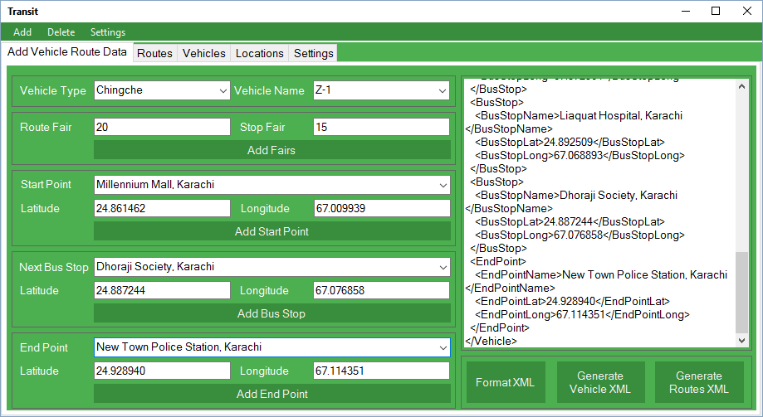
Transit Tool
Entering Transport Data in Transit Tool

Slide 12
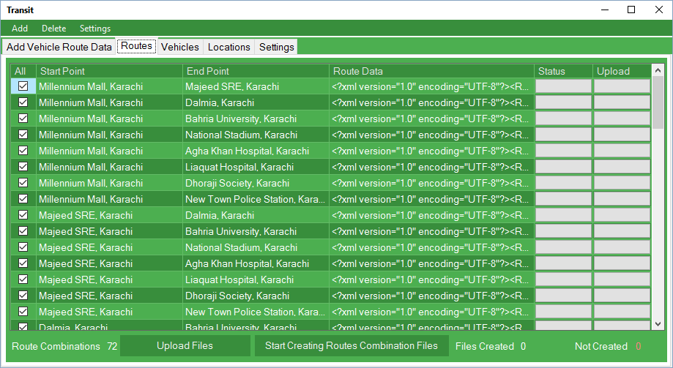
Transit Tool
Routes Files Generation in Transit Tool

Slide 13
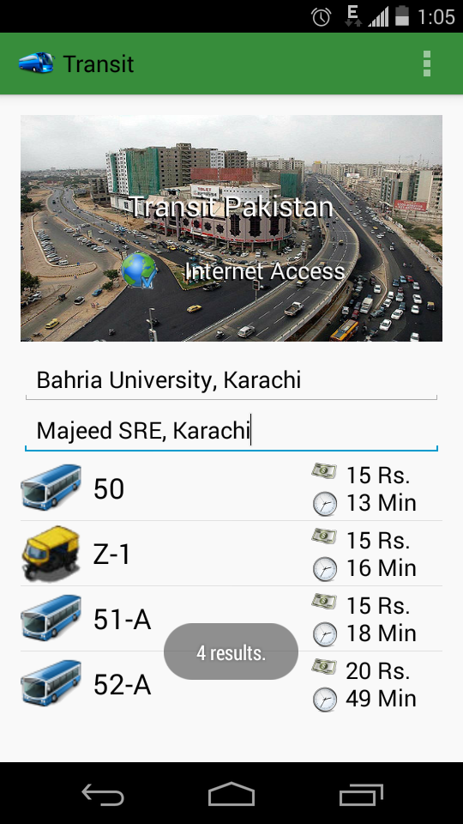
Transit Mobile App
Ride Suggestions with Time and Fair

Slide 14
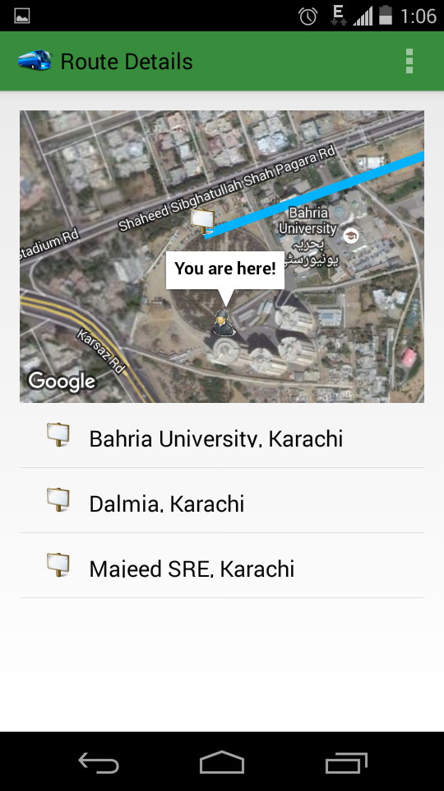
Transit Mobile App
User Navigation on Google Map inside Transit App

Slide 15
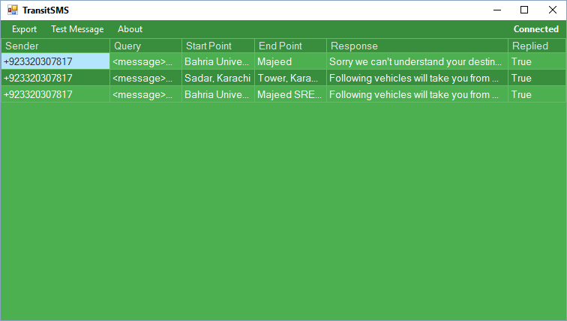
Transit SMS Module
Received Messages with Responses in Transit SMS

Slide 16
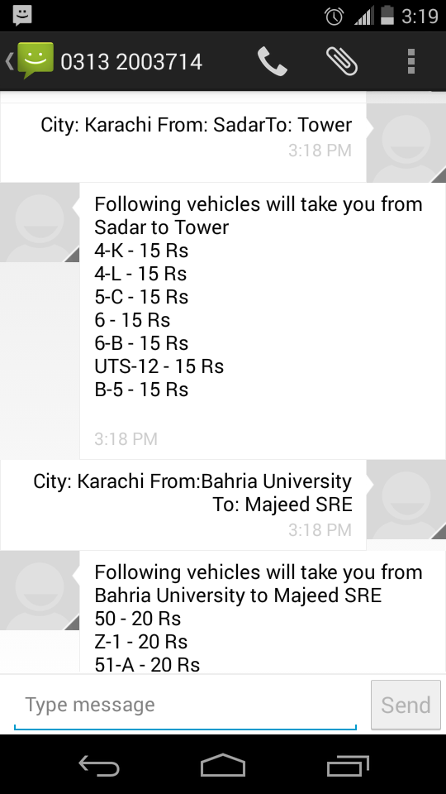
Transit SMS Service
Sample Response from Transit SMS Service

Slide 17
The End

